Slide 1
DSA
Linked List

Slide 2
Types Of Linked List
Singly linked list
Circular Single Linked list
Doubly Linked List
Circular Doubly Linked List

Slide 3
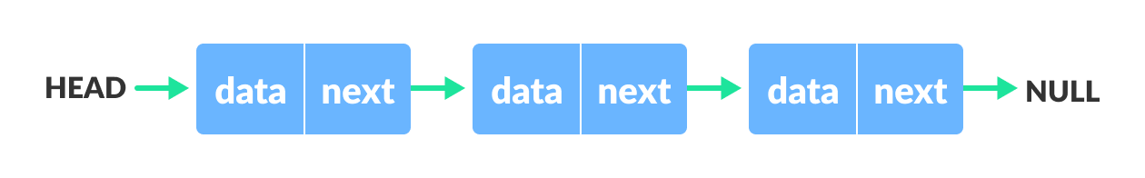
Singly linked list
A singly linked list is a linear data structure consisting of a sequence of elements called nodes.
Each node contains two parts: the data it holds and a reference (or link) to the next node in the sequence. The first node in the list is called the head, and the last node's reference points to null called as Tail, indicating the end of the list.
For example :

Slide 4
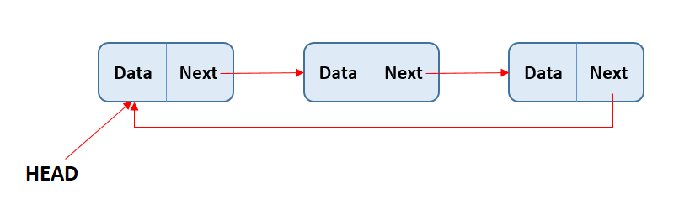
Circular Singly Linked list
A Circular Singly Linked List is a variation of the singly linked list, where the last node's next reference points back to the first node, forming a circular structure.
In a regular singly linked list, the last node's next reference is null, indicating the end of the list
Example : Undo and redo functionality in text editors

Slide 5
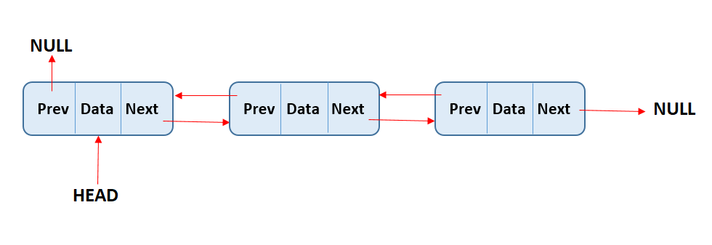
Doubly Linked List
A doubly linked list is a data structure that consists of a set of nodes, where each node contains two pointers: one that points to the next node and another that points to the previous node.
This allows for easy traversal of the list in both directions, forward and backward.
For Example : Text Editor and Web browser

Slide 6
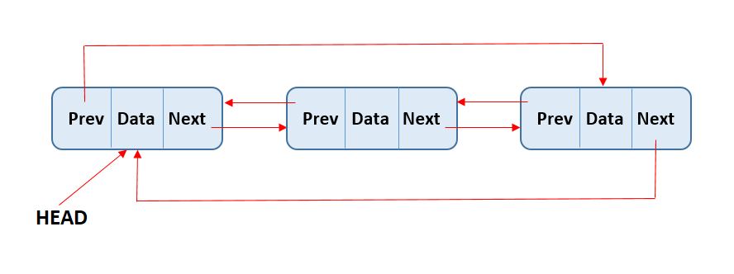
Circular Doubly Linked List
A circular doubly linked list is a type of doubly linked list in which the last node points back to the first node, forming a circle. This means that there is no "tail" node, and the list can be traversed infinitely.
Example : Music playlist and Chat History

Slide 7
Thanks For Watching

